Slide 1
Building GB – Cy Investment Bridges
GB – Cy Investment Conference

Slide 2
Cyprus to be one of the world’s best countries to live, work and do business in
Long Term Vision 2035:
GB – Cy Investment Conference

Slide 3
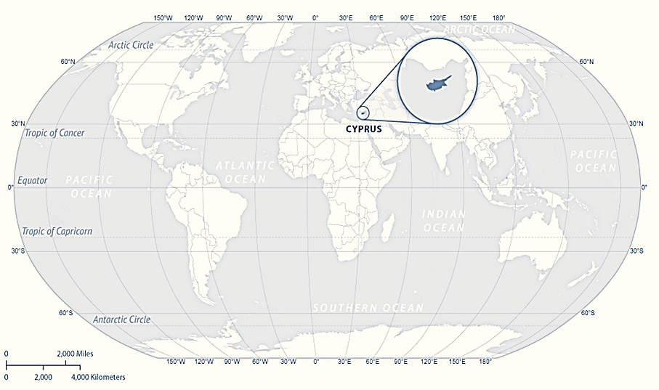
Cyprus at a glance
9,251 km²
Area
Geostrategic Location
Between 3 continents
Population
888k
Greek
Official
English
Widely Spoken
EU Member
State 2004/ Eurozone 2008
40+ EU Trade Agreements
66 double tax treaties
GB – Cy Investment Conference

Slide 4
Why Cyprus?
Attractive tax regime
Reliable business support services
Positive Economic Outlook
Reliable business support services
Access to Talent
Low cost of doing business
Access to Markets
Excellent Regulatory Structure
High quality of life
GB – Cy Investment Conference

Slide 5
Our Vision
A sustainable development model driven by research, innovation and technological advancement
A resilient business center and regional player, catering to the needs of international businesses and professionals choosing to make the island their home§
GB – Cy Investment Conference

Slide 6
Strategy, people & culture: Our toolbox for accelerated transformation
Vision & strategy through Execution
People at the Center: Upskill and enable talent
Iterate, scale and accelerate

Slide 7
INSERT VIDEO HERE

Slide 8
Vision and action pillars
A fit-for-the-future society and knowledge-based economy enabled by digital and emerging technologies that will drive sustainable growth, social prosperity and competitiveness
A digitally skilled population and highly skilled
digital professionals
Digitalization of public services
04
01
Digital transformation of businesses
03
02
Secure and sustainable digital infrastructures
GB – Cy Investment Conference

Slide 9
A key regional player for High Tech and ICT
01
Ideal HQ location for High Tech companies, a robust platform for accessing high-growth markets
02
Attractive relocation destination for Scientists and Tech professionals
03
Gateway into and out of the EU, a business bridge between three continents
04
Sandbox for new emerging technologies (Blockchain, AI, Big Data, etc.)
05
International broadband connectivity hub
GB – Cy Investment Conference

Slide 10
Access to Talent
Highly skilled professionals
Specialised offering
International business experience
Attractive relocation destination
Multilingual workforce
Highest EU tertiary education attainment
Easy access to global and European talent
GB – Cy Investment Conference

Slide 11
Strategy for attracting business and talent -Human Capital is our propulsive fuel for our future
Creation of a best-in-class competitive and modern, business-friendly environment
03
Comprehensive strategy that actively promotes continuous reforms and provides support and incentives to foreign investors & companies.
02
Specialised, highly professional services, Fast-Track mechanism and ‘personalised service
01
GB – Cy Investment Conference

Slide 12
Numerous investment opportunities
Cyprus has many new and existing projects seeking for expansion and in search of strategic investors and partners, in sectors such as:
Renewable Energy
Healthcare & Bio-Technology
Tourism and Hospitality
Higher Education
ICT and Fintech
Real Estate
Shipping
GB – Cy Investment Conference

Slide 13
Home to tech multinationals, and more …
Republic of Cyprus / copyright 2021
MINISTRY OF INTERIOR
DEPUTY MINISTRY OF RESEARCH, INNOVATION AND DIGITAL POLICY
GB – Cy Investment Conference

Slide 14
We invest in TECHNOLOGY and HUMANS
STEM
HECI
Science
Humanities
Technology
Ethics
Engineering
Creativity
Mathematics
Imagination

Slide 15
Innovation and Entrepreneurship
The skills of the future
Cognitive
Interpersonal
Digital
Leadership
Critical thinking
Communication
Planning & ways of working
Mental flexibility
Mobilizing systems
Developing relationships
Teamwork effectiveness
You cannot discover new oceans unless you have the courage to lose sight of the shore
Self-awareness and self-management
Entrepreneurship
Goals achievement
Digital fluency & citizenship
Software use & development
Understanding digital systems
Andre Gide
Source: McKinsey,
The Future of Work
Emphasis on digital and social skills (“soft skills”)
GB – Cy Investment Conference

Slide 16
Key interventions
TAX Incentives
Business Facilitation Unit, simplified & digitized process
Digital Nomad Visa for 1 yr (right to renew for 2 more)
Broadening and simplification of employment policy for third country nationals (including right to family reunification)
1st gov Equity fund of €30m – for SMEs, startups/ innovative companies – opportunity for international VCs
Reduced Naturalization Period for Non-EU Nationals (from 7 to 5 yrs,)
Startup Visa Scheme (for 2 yrs, possibility of renewal)
GB – Cy Investment Conference

Slide 17
Public Sector Transformation
Culture
Structure
Processes
Systems
GB – Cy Investment Conference

Slide 18
Public Sector Transformation
TRANSFORMATION STRATEGY
PROJECT MANAGEMENT
LEADERSHIP
STRUCTURE
SYSTEMS
PROCESSES
CULTURE
CHANGE MANAGEMENT
COMMUNICATION
GB – Cy Investment Conference

Slide 19
Challenge: Managing Change
GB – Cy Investment Conference

Slide 20
Human centricity is key
GB – Cy Investment Conference

Slide 21
Impact-oriented initiatives …
Reflected in EU digital & innovation indices
GB – Cy Investment Conference

Slide 22
European Innovation Scoreboard 2022
Cyprus skyrocketed in the Strong Innovators category
GB – Cy Investment Conference

Slide 23
Joined Europe’s Strong Innovators in EIS 2022
10th
1st
in performance increase from
in Europe
GB – Cy Investment Conference

Slide 24
Up 4 places in DESI ranking in 2 years
GB – Cy Investment Conference

Slide 25
THE BOARDROOM BUZZWORDS FOR 2023: "POLYCRISIS"​ & "PERMACRISIS"​
DO YOU HAVE THE SYSTEMS THINKING & MANAGEMENT OF COMPLEXITY CAPABILITIES TO SURVIVE THE PERFECT STORM?
Source: Paul Barnett, Founder, Enlightened Enterprise Academy; Co-Founder, Critical Systems Forum , Jan 23

Slide 26
Our journey has started ….. Let’s sail together
Thank you!
GB – Cy Investment Conference

Slide 27
“You cannot discover new oceans unless you have the courage to lose sight of the shore”
Andre Gide

