Slide 1
Business Orientation: Cyprus 2021 Great Britain-Cyprus Business Association
Nicos Nouris, Minister of Interior
London, 23rd November 2021
MINISTRY OF INTERIOR
Republic of Cyprus / Copyright 2021

Slide 2
Geostrategic position Proximity and easy access to major markets Full access to the European Single Market 40+ EU Trade Agreements 65 double tax treaties
Access to key markets
Commonwealth, EU (2004) and
Eurozone member (2008)
MINISTRY OF INTERIOR
Republic of Cyprus / Copyright 2021

Slide 3
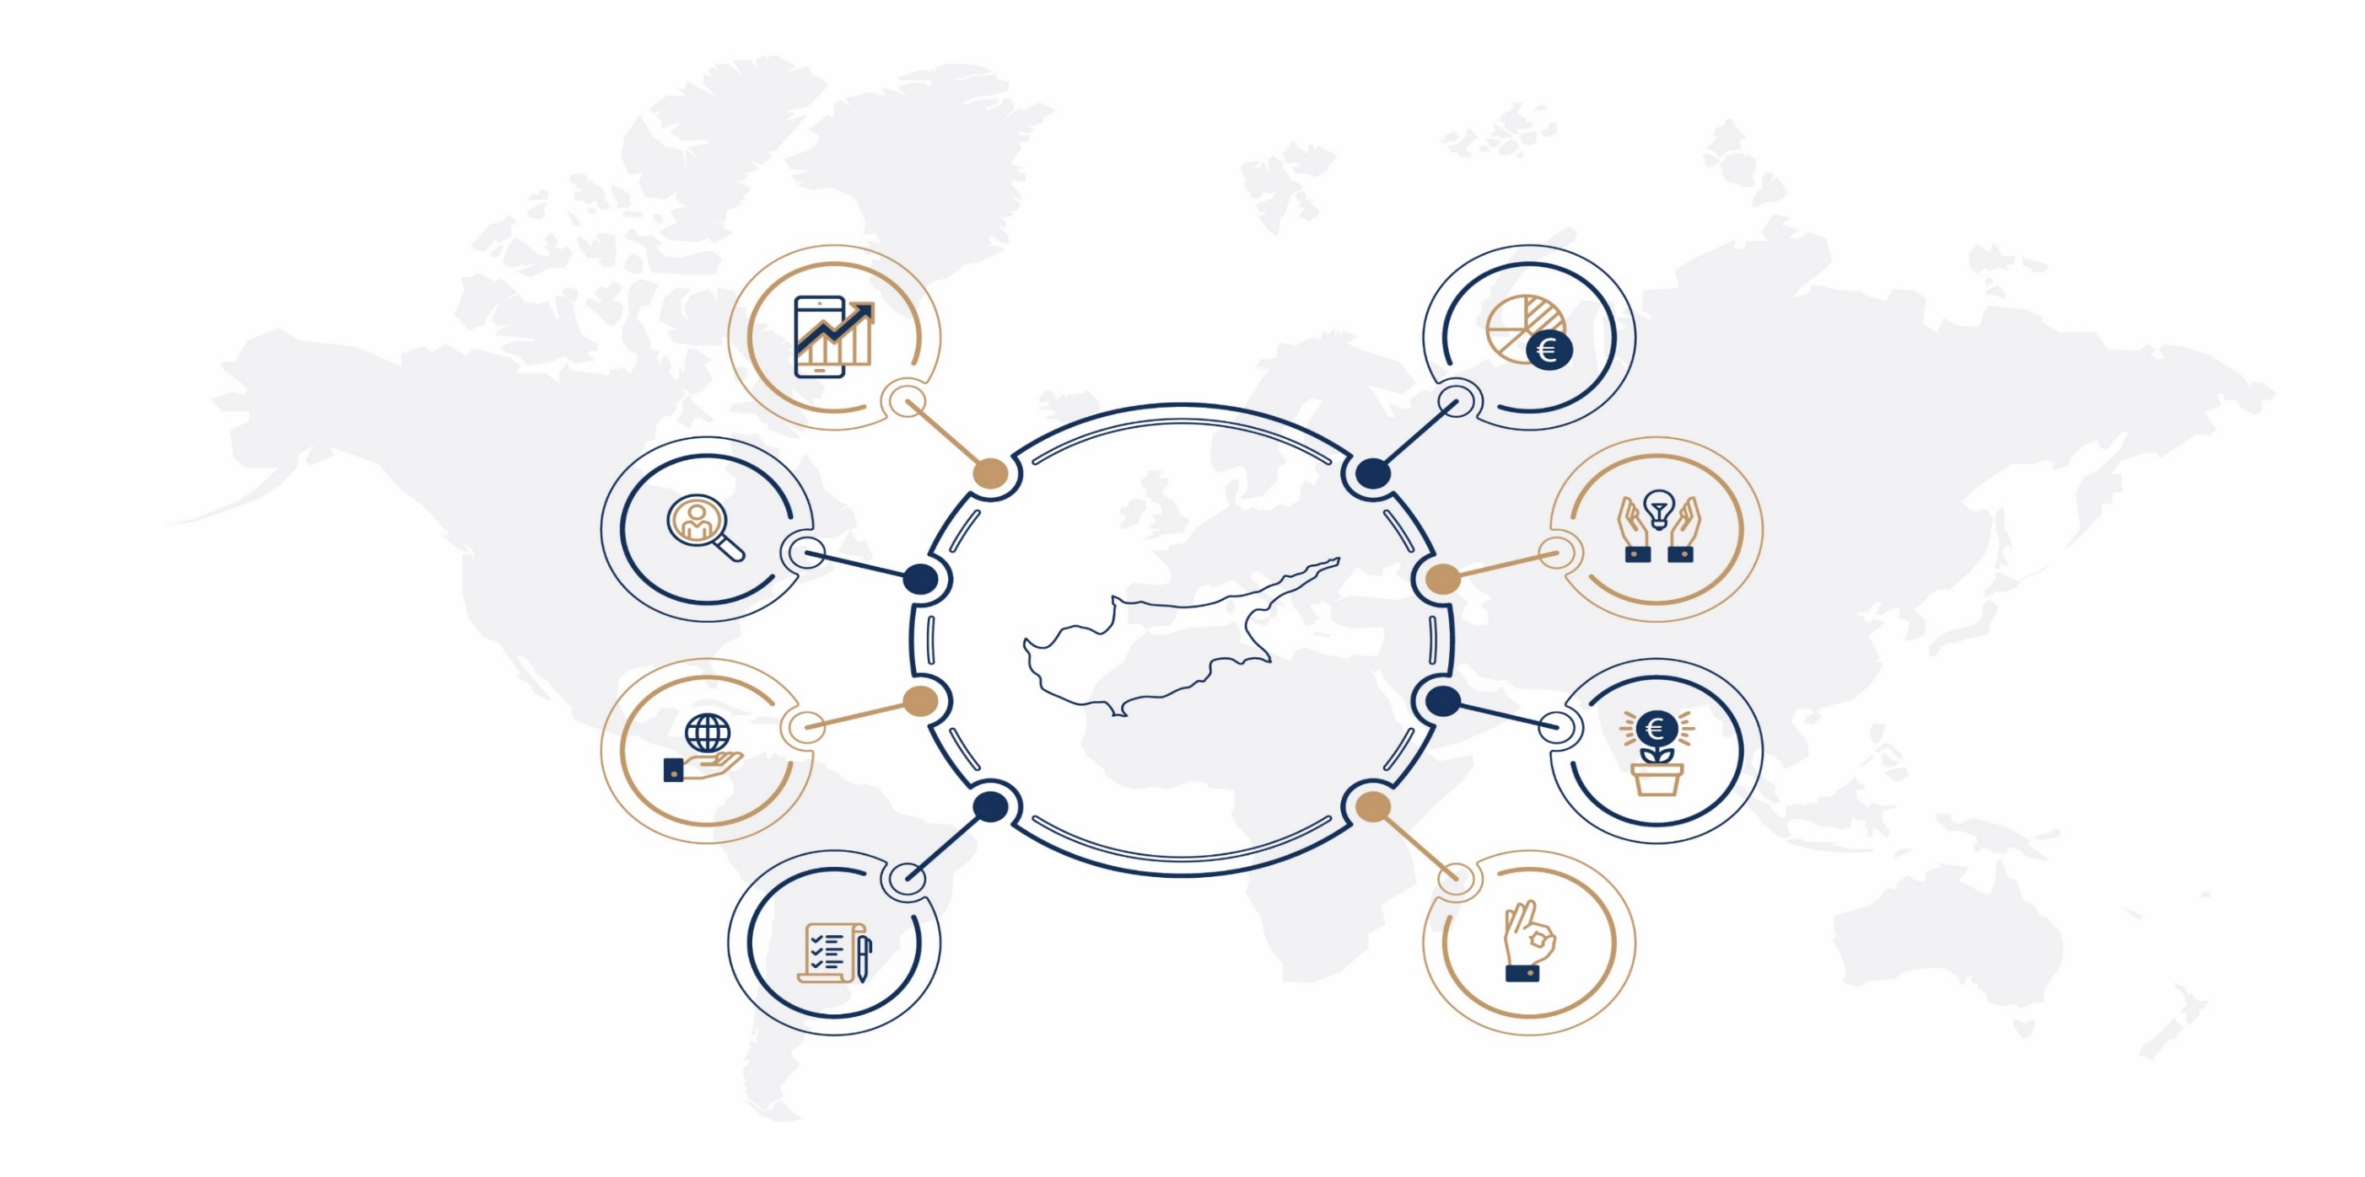
Why Cyprus: An ideal base within the EU
Positive economic outlook
Attractive tax regime
Access to talent
Reliable business support services
Access to markets
Low cost of doing business
Excellent regulatory structure
High quality of life
MINISTRY OF INTERIOR
Republic of Cyprus / Copyright 2021

Slide 4
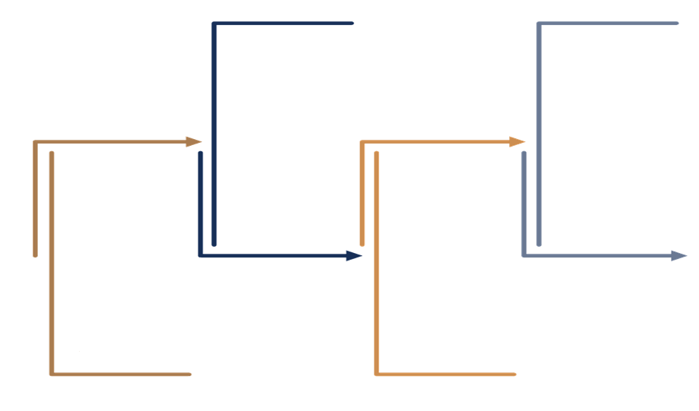
Cyprus: Economic Outlook
2021-2023
Economic Recovery
GDP average growth rates
at 4.3%
Cyprus stable outlook by International Credit Rating Agencies
2020 GDP Real
Cyprus -5.1%
EU –5.9%
Eurozone –6.3%
Sep 2021
Unemployment
Cyprus 3.6%
EU 6.7%
Eurozone 7.4%
MINISTRY OF INTERIOR
Republic of Cyprus / Copyright 2021

Slide 5
Excellent regulatory structure
Closely aligned to the English common law legal system
Compliance with EU and international laws and regulations
Transparency and reliability in business practices
Frequently updated to meet investors’ changing needs
Strong protection for investment & intellectual property (IP)
Strong legislative framework for Investment Funds
Legal system
Establishing a business is simple and fast
Simplest filing requirements for companies in the EU
Setup and filing
MINISTRY OF INTERIOR
Republic of Cyprus / Copyright 2021

Slide 6
Strong business support services
Registered accountants
3900+
Registered accounting firms
700+
160+
Registered law firms
Service-based economy
Strong
network of financial and professional
services
Registered lawyers
80%
2700+
MINISTRY OF INTERIOR
Republic of Cyprus / Copyright 2021

Slide 7
Low cost of doing business
Average hourly rate are below EU average
Non-wage labour costs are below EU average
Highly affordable critical business support services of the highest quality
Labour costs
Property costs
Business services
Cost of living
Among the lowest office rental rates in Europe
Competitive residential property prices
The lowest cost of living amongst Western EU countries
MINISTRY OF INTERIOR
Republic of Cyprus / Copyright 2021

Slide 8
Access to high-quality talent
Highly skilled professionals
International business experience
Specialised offering
Multilingual workforce
Attractive relocation destination
58% of the workforce
(aged 30 to 34) has a tertiary degree, well above the EU average of 46%
Highest EU tertiary education attainment
Easy access to global and European talent
MINISTRY OF INTERIOR
Republic of Cyprus / Copyright 2021

Slide 9
High quality of life
Top 5 safest country in the world
(Value Penguin)
Top 4 best retirement destination globally (Knight Frank)
Best island economy “lifestyle & human capital” (FDI magazine)
Most blue flag beach per capita in the EU
(Eurostat)
MINISTRY OF INTERIOR
Republic of Cyprus / Copyright 2021

Slide 10
Low cost of living
Cost of living Index
Source: CEOWORLD Magazine, 2020 prices
Republic of Cyprus / Copyright 2021
MINISTRY OF INTERIOR
Notes:
Here ,I would just like to give you a quick example of the cost of living index, and how Cyprus compares to other EU members, such as Luxembourg, Ireland, Netherlands, and Malta. You can see that Cyprus is a more cost-competitive jurisdiction.

Slide 11
Growth Sectors
Hospitality &
Tourism
ICT, Research & Innovation
Shipping
Professional Services
Real Estate/Construction
Investment Funds
Higher Education
Energy
Republic of Cyprus / Copyright 2021
MINISTRY OF INTERIOR

Slide 12
Key incentives for foreign companies
Fast Track Business
Activation Mechanism
(September 2020)
Business Facilitation Unit
(October 2021)
Attractive IP Regime
and Income tax exemptions up to 50% on remuneration
Relocation of employees from non-EU countries
Republic of Cyprus / Copyright 2021
MINISTRY OF INTERIOR

Slide 13
Business Facilitation Unit
Transformation of the Fast Track Business Activation Mechanism into a Business Facilitation Unit
MINISTRY OF INTERIOR
Republic of Cyprus / Copyright 2021

Slide 14
New Incentives Package
Reduced Naturalization Period for Non-EU Nationals
Revised Immigration Policy for International Businesses
06
01
01
05
02
Family Reunification & Employment of Family Members
TAX Incentives
04
03
Social Insurance Agreements
Digital Nomad Visa
Republic of Cyprus / Copyright 2021
MINISTRY OF INTERIOR

Slide 15
An international Business Center
Republic of Cyprus / copyright 2021
MINISTRY OF INTERIOR

Slide 16
Tech and Research Ecosystem
Incubators, Accelerators, Centres of Excellence
Republic of Cyprus / Copyright 2021
MINISTRY OF INTERIOR

Slide 17
European Innovation Scoreboard 2021
Performance has increased the most in
Estonia
Cyprus
Lithuania
Italy
Greece
European Commission
Republic of Cyprus / Copyright 2021
MINISTRY OF INTERIOR

Slide 18
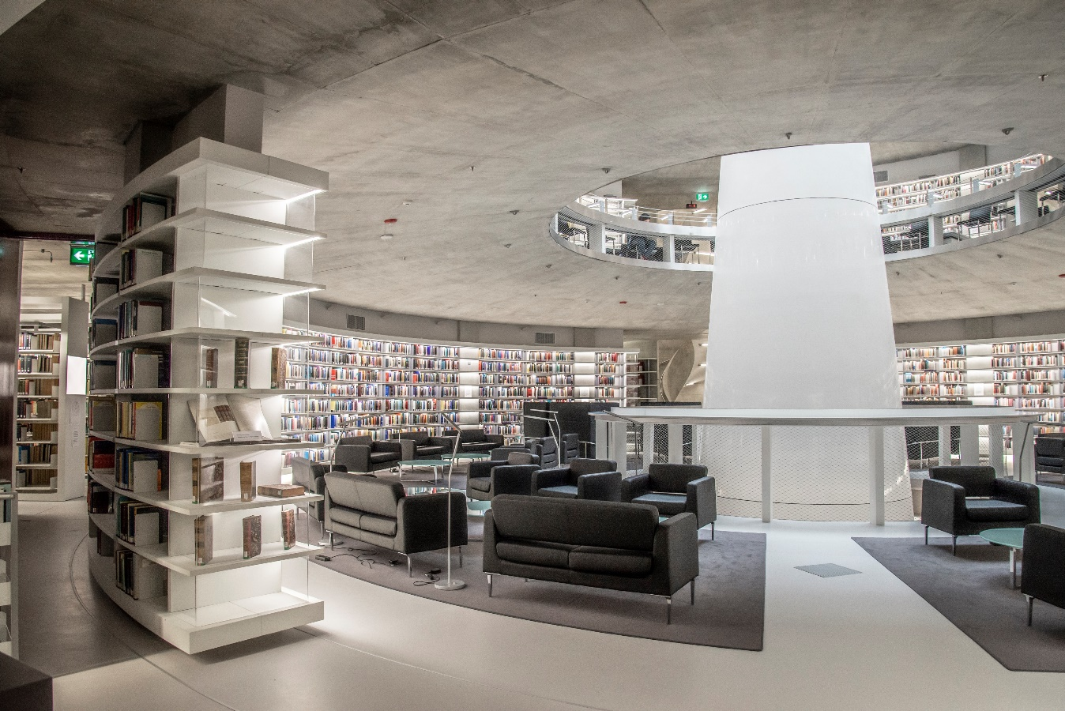
Quality Higher Education in Cyprus
10
Universities
40
Institutes of Higher Education / Colleges
Republic of Cyprus / Copyright 2021
MINISTRY OF INTERIOR

Slide 19
New Development Licensing Policy
Aims to modernize and simplify the development of licensing procedures to create a more flexible and modern licensing framework
MINISTRY OF INTERIOR
Republic of Cyprus / Copyright 2021

Slide 20
New Licensing Policy
Investment Facilitation Law
Submitted to the Committee of Internal Affairs, (February 2020)
Pending approval by the House of Representatives
Strategic Developments / Large Investments (>€25M)
Facilitates and simplifies licensing procedures
Aims to attract quality Foreign Direct Investments
MINISTRY OF INTERIOR
Republic of Cyprus / Copyright 2021

Slide 21
Revision of Local Plans
Introduction of Innovative and dynamic urban Planning Tools
Promoting sustainable development
Protection of the natural und built environment
Spatial and Urban Planning through resilience and adaptability
Aiming at a new, modernized form of local plans in major urban areas
MINISTRY OF INTERIOR
Republic of Cyprus / Copyright 2021

Slide 22
Cyprus Attractiveness Survey 2020
Quality of Life
Telecommunication
and Digital Infrastructure
Stable political and social environment
99%
90%
Entrepreneurial culture
& startup culture
Local labour
skills level
Research & Development availability & quality
86%
81%
80%
Republic of Cyprus / Copyright 2021
ΥΠΟΥΡΓΕΙΟ ΕΣΩΤΕΡΙΚΩΝ
MINISTRY OF INTERIOR

Slide 23
Contacts
Marios Tannousis
Deputy Director General, Invest Cyprus
mtannousis@investcyprus.org.cy
+357 22441133
Republic of Cyprus / Copyright 2021
ΥΠΟΥΡΓΕΙΟ ΕΣΩΤΕΡΙΚΩΝ
MINISTRY OF INTERIOR

Slide 24
Ευχαριστούμε
Thank you!
MINISTRY OF INTERIOR
Republic of Cyprus / Copyright 2021
ΚΥΠΡΙΑΚΗ ΔΗΜΟΚΡΑΤΙΑ / ΠΝΕΥΜΑΤΙΚΑ ΔΙΚΑΙΩΜΑΤΑ 2020

